Slide 1
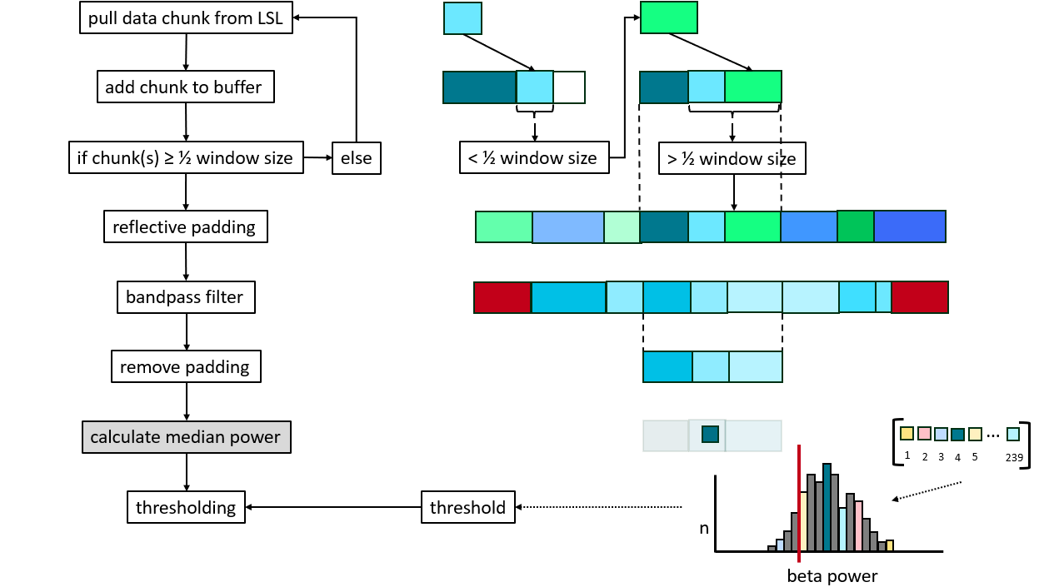
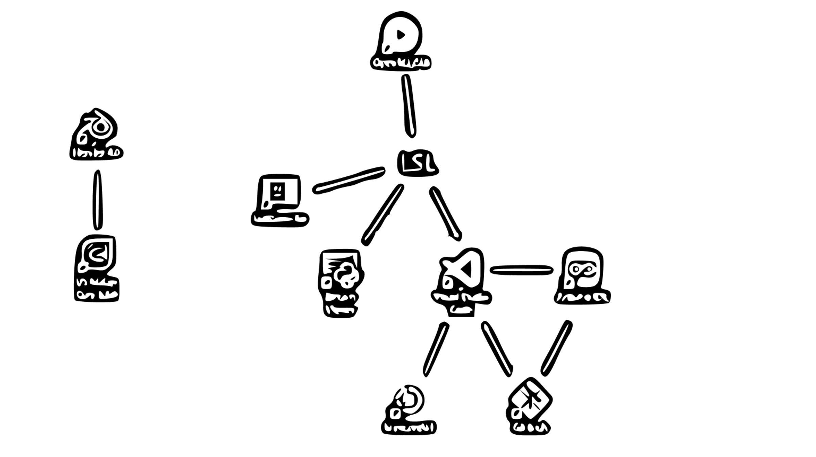

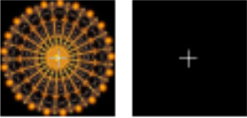




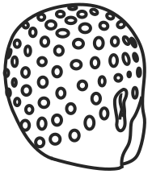


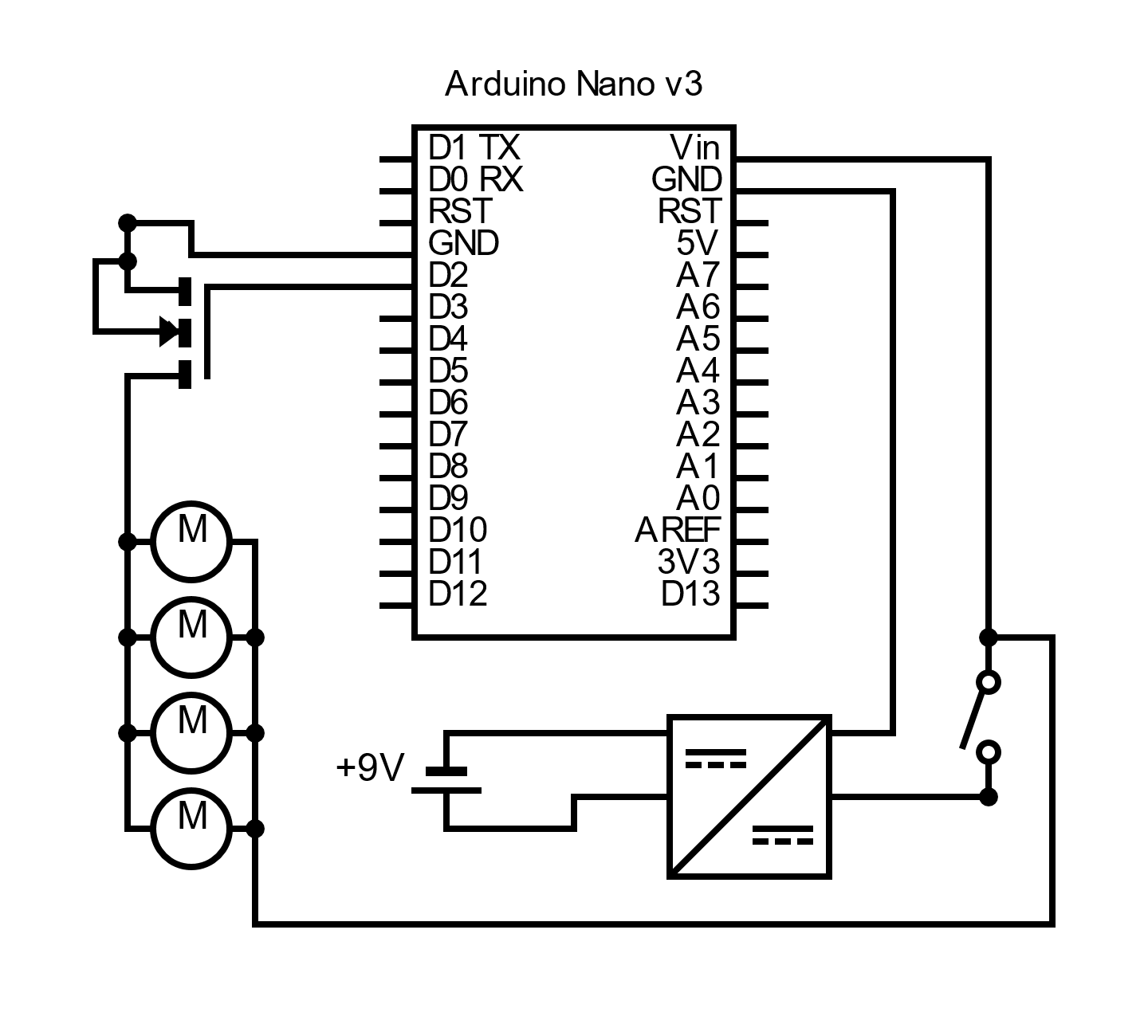
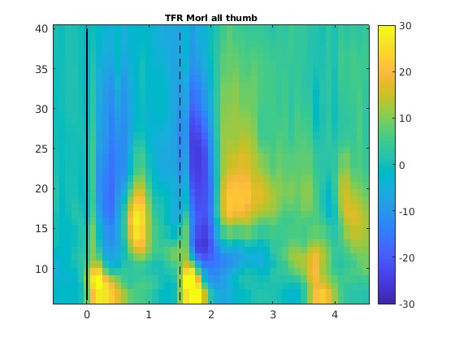
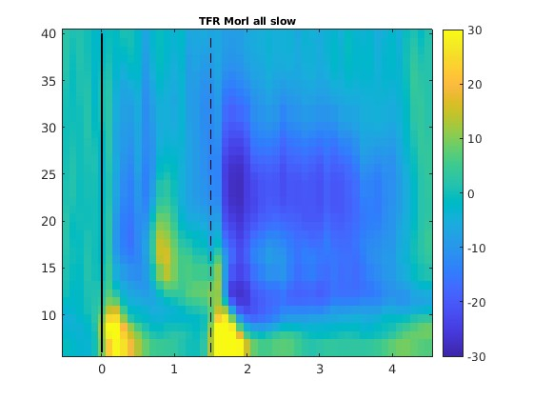
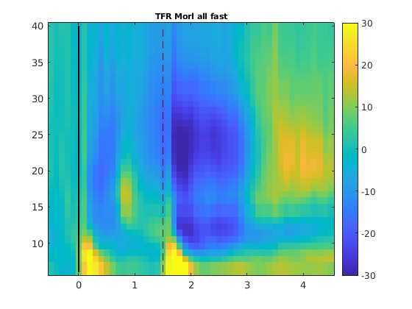
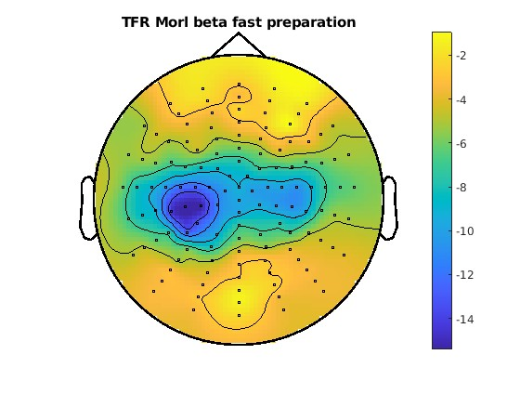


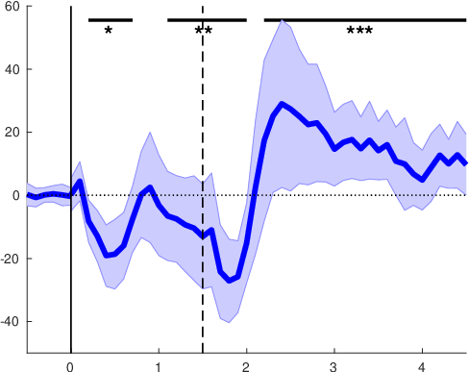
rtNFB
software
haptic feedback
cqEEG
LMM | RT ~ 1 + power + (1|subject)
power [s] | 0 – 1.5 | 0 – 0.3 | 0.4 - 0.7 | 0.8 – 1.1 | 1.2 -1.5
mu | 0.354 | 0.203 | 0.370 | 0.013 | 0.761
lowB | 0.066 | 0.588 | 0.007 | 0.021 | 0.992
highB | 0.742 | 0.538 | 0.854 | 0.083 | 0.861
beta | 0.246 | 0.501 | 0.150 | 0.022 | 0.984

Slide 2
software
rtNFB
cqEEG
haptic feedback
LMM | RT ~ 1 + power + (1|subject)
power [s] | 0 – 1.5 | 0 – 0.3 | 0.4 - 0.7 | 0.8 – 1.1 | 1.2 -1.5
mu | 0.354 | 0.203 | 0.370 | 0.013 | 0.761
lowB | 0.066 | 0.588 | 0.007 | 0.021 | 0.992
highB | 0.742 | 0.538 | 0.854 | 0.083 | 0.861
beta | 0.246 | 0.501 | 0.150 | 0.022 | 0.984

Slide 3
software
rtNFB
cqEEG
haptic feedback
LMM | RT ~ 1 + power + (1|subject)
power [s] | 0 – 1.5 | 0 – 0.3 | 0.4 - 0.7 | 0.8 – 1.1 | 1.2 -1.5
mu | 0.354 | 0.203 | 0.370 | 0.013 | 0.761
lowB | 0.066 | 0.588 | 0.007 | 0.021 | 0.992
highB | 0.742 | 0.538 | 0.854 | 0.083 | 0.861
beta | 0.246 | 0.501 | 0.150 | 0.022 | 0.984

Slide 4
TFRs
rtNFB
software
Fast
cqEEG
Slow
Thumb
Frequency [Hz]
LMM | RT ~ 1 + power + (1|subject)
power [s] | 0 – 1.5 | 0 – 0.3 | 0.4 - 0.7 | 0.8 – 1.1 | 1.2 -1.5
mu | 0.354 | 0.203 | 0.370 | 0.013 | 0.761
lowB | 0.066 | 0.588 | 0.007 | 0.021 | 0.992
highB | 0.742 | 0.538 | 0.854 | 0.083 | 0.861
beta | 0.246 | 0.501 | 0.150 | 0.022 | 0.984
Time [s]
haptic feedback

Slide 5
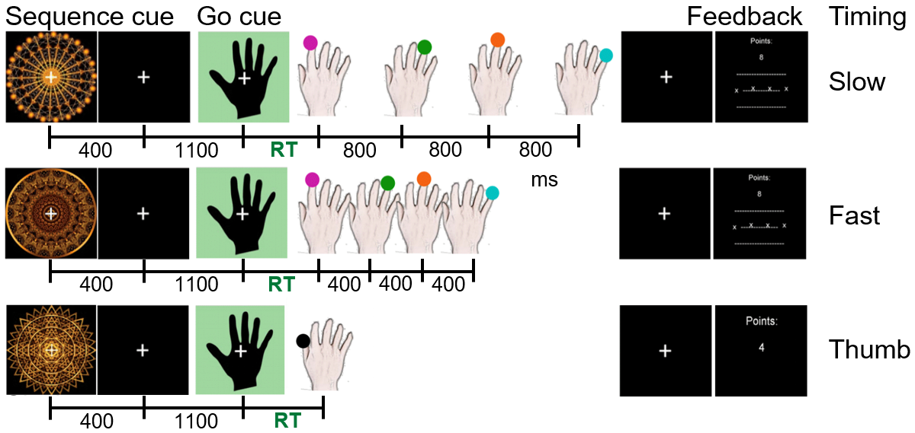
Task Finger sequence production from memory
Behavioural measures: reaction time (RT) + timing accuracy
Notes:
18 healthy participants
Discrete sequence production task:
3 conditions: slow, fast, single press (control)
Learned to produce the finger sequence from memory
…and to associate an abstract fractal image with each condition
On each trial:
sequence cue
-> 1.5s to prepare the finger sequence
1st press should be as quick as possible, which is the RT that I will refer to later
Slow condition: 800ms intervals between the key presses – fast condition: only 400ms
Feedback: RT + accuracy of their timing

Slide 6
Time-frequency representations (TFRs)
Slow
Fast
Thumb
Frequency [Hz]
Power [percent change]
Time [s]
ERD occurs during movement sequence preparation & production
Notes:
EEG data: offline analysis
Oscillatory activity over motor cortex – how it changes during trial:
Color: power
… and ERD is a decrease in power – so the blue parts
1) Duration of ERD during movement production is dependent on the condition – bcs in the slow condition the presses were spaced further apart than in the fast condition, and in the thumb condition it was just one quick finger movement
2) After the movement sequence we see a beta rebound – ie high power – except for slow condition (cut off at end of plot)
3) IMPORTANT: we see the same pattern during preparation of the movement sequence: first ERD then rebound

Slide 7
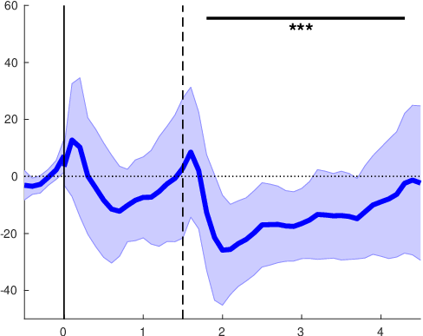
Cluster-based permutation test
Thumb
Fast
Slow
During what times in a trial can we see significant deviations from baseline?
Power [percent change]
mu
Time [s]
ERD during production, but not preparation
Notes:
Test statistically: During what times in a trial the neuronal activity significantly deviates from baseline?
Mu:
- preparation: fluctuates around 0
- production: cluster of very significant ERD

Slide 8
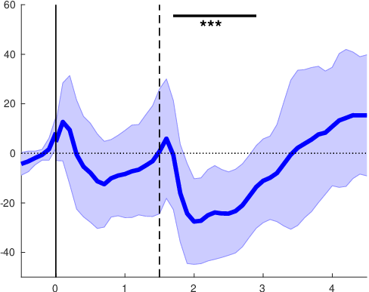
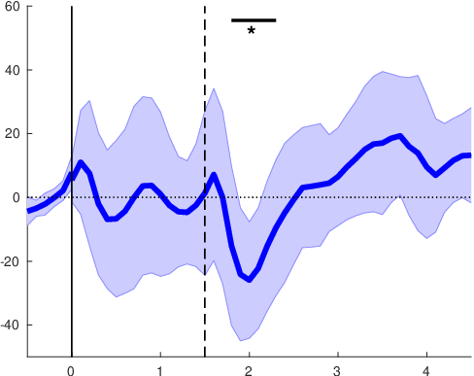
Cluster-based permutation test
Slow
Fast
Thumb
Power [percent change]
mu
Time [s]
Notes:
In the other two conditions we see the same thing for mu:
Significant clusters during production
Again: they get shorter depending on the condition

Slide 9
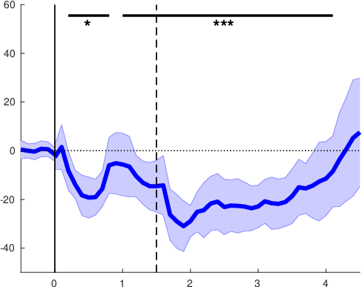
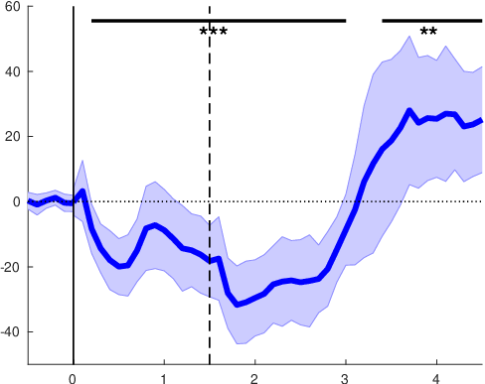
Cluster-based permutation test
Slow
Fast
Thumb
mu
Power [percent change]
beta
Time [s]
ERD during preparation only in beta
Notes:
IMPORTANT difference in beta:
ERD – as we saw before- is also observable during the preparation phase
And, similar to mu, also during production

Slide 10
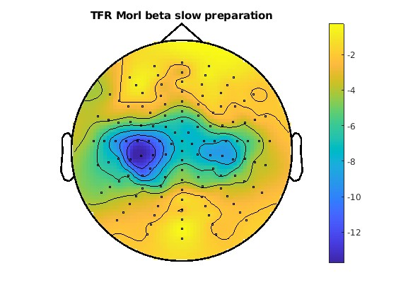
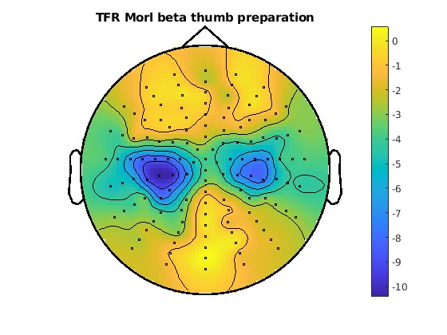
Topographies beta (13-30 Hz) - planning
Slow
Fast
Thumb
Beta ERD occurs over contralateral motor cortex
Notes:
…where in the brain the beta ERD occurs?
-> Contralateral motor cortex
… in all 3 conditions – very similar

Slide 11
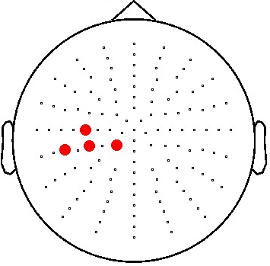
Linear mixed models (LMMs)
Predictors of behaviour:
- Which frequency band …
- at what time during preparation …
- predicts RT and sequence timing?
p-values
LMM | RT ~ 1 + power + (1|subject)
power [s] | 0 – 1.5 | 0 – 0.3 | 0.4 - 0.7 | 0.8 – 1.1 | 1.2 -1.5
mu | 0.354 | 0.203 | 0.370 | 0.013 | 0.761
lowBeta | 0.066 | 0.588 | 0.007 | 0.021 | 0.992
highBeta | 0.742 | 0.538 | 0.854 | 0.083 | 0.861
beta | 0.246 | 0.501 | 0.150 | 0.022 | 0.984
timingAccuracy ~ 1 + power + (1|subject)
0 – 1.5 | 0 – 0.3 | 0.4 - 0.7 | 0.8 – 1.1 | 1.2 -1.5
0.121 | 0.256 | 0.647 | 0.160 | 0.430
0.010 | 0.248 | 0.131 | 0.037 | 0.160
<.001 | 0.061 | 0.040 | 0.007 | 0.027
<.001 | 0.082 | 0.030 | 0.004 | 0.029
Beta power between 0.4 - 1.1s is most predictive of behaviour
Notes:
LMMs: Which frequency band … at what time during preparation … predicts RT and sequence timing?
We modelled RT and timingAccuracy with an intercept, power as fixed effect, and subjects as random effect.
Mu and lowBeta predict RT in the 400-1100ms interval of the preparation period
lowBeta seems to drive this significance if we look at the whole beta band
timingAccuracy is only predicted by beta, not mu, in the same time intervals.

Slide 12
Linear mixed models (LMMs)
Predictors of behaviour:
- Which frequency band …
- at what time during preparation …
- predicts RT and sequence timing?
p-values
neg corr
pos corr
LMM | RT ~ 1 + power + (1|subject)
power [s] | 0 – 1.5 | 0 – 0.3 | 0.4 - 0.7 | 0.8 – 1.1 | 1.2 -1.5
mu | 0.354 | 0.203 | 0.370 | 0.013 | 0.761
lowBeta | 0.066 | 0.588 | 0.007 | 0.021 | 0.992
highBeta | 0.742 | 0.538 | 0.854 | 0.083 | 0.861
beta | 0.246 | 0.501 | 0.150 | 0.022 | 0.984
maxERD | 0.311 | 0.047 | 0.797 | 0.594 | 0.235
timingAccuracy ~ 1 + power + (1|subject)
0 – 1.5 | 0 – 0.3 | 0.4 - 0.7 | 0.8 – 1.1 | 1.2 -1.5
0.121 | 0.256 | 0.647 | 0.160 | 0.430
0.010 | 0.248 | 0.131 | 0.037 | 0.160
<.001 | 0.061 | 0.040 | 0.007 | 0.027
<.001 | 0.082 | 0.030 | 0.004 | 0.029
0.027 | 0.129 | 0.137 | 0.271 | 0.239
High inter-subject variability in narrow frequency band that shows maximal ERD
Notes:
What we didn’t expect is, that these correlations were negative.
So, we ran further analyses, and due to the fact, that there’s a lot of inter-subject variability, we constricted the frequencies we looked at to a 5Hz band centered on the maximal ERD of each subject.
This approach has also been used in very similar studies.
… and resulted in the expected positive correlation between power and RT.

Slide 13
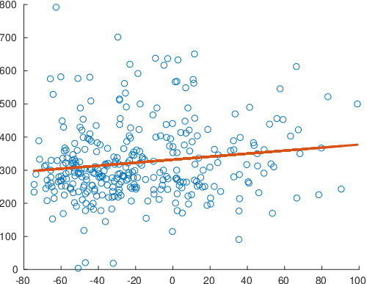
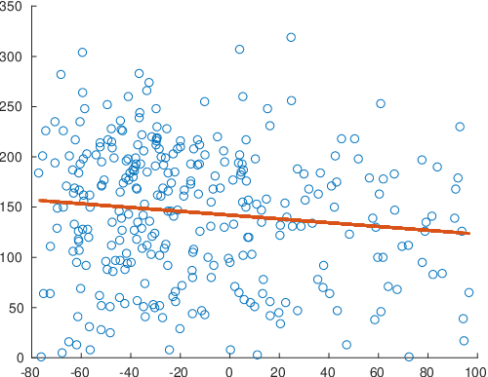
Inter-subject variability
Subject 1
Subject 3
p = 0.009
p = 0.033
RT [ms]
Power [relative change]
Different subjects show reversed relationships between power and RT
Notes:
We did some further analyses to look at individual subjects, and it really surprised us that the relation between behaviour and power can be reversed between subjects.
E.g. for subject 4, low power predicts low RTs, while for subject 6, high power predicts fast RTs.
Going forward, and thinking of our implementation of the BCI, we think that we need to first run a short RT test to determine this association for each participant and then feedback accordingly.

Slide 14
rtNFB
software
cqEEG
LMM | RT ~ 1 + power + (1|subject)
Power [ms] | 0 - 1500 | 0 - 300 | 400 -700 | 800 -1100 | 1200 -1500
Mu |  | * [+]
lowBeta |  |  | **[-]
highBeta
Beta |  |  | ** [-]
haptic feedback

Slide 15
software
rtNFB
cqEEG
haptic feedback
LMM | RT ~ 1 + power + (1|subject)
power [s] | 0 – 1.5 | 0 – 0.3 | 0.4 - 0.7 | 0.8 – 1.1 | 1.2 -1.5
mu | 0.354 | 0.203 | 0.370 | 0.013 | 0.761
lowB | 0.066 | 0.588 | 0.007 | 0.021 | 0.992
highB | 0.742 | 0.538 | 0.854 | 0.083 | 0.861
beta | 0.246 | 0.501 | 0.150 | 0.022 | 0.984

Slide 16
software
rtNFB
cqEEG
haptic feedback
LMM | RT ~ 1 + power + (1|subject)
power [s] | 0 – 1.5 | 0 – 0.3 | 0.4 - 0.7 | 0.8 – 1.1 | 1.2 -1.5
mu | 0.354 | 0.203 | 0.370 | 0.013 | 0.761
lowB | 0.066 | 0.588 | 0.007 | 0.021 | 0.992
highB | 0.742 | 0.538 | 0.854 | 0.083 | 0.861
beta | 0.246 | 0.501 | 0.150 | 0.022 | 0.984

Slide 17
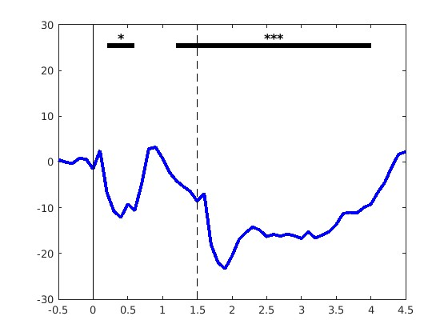
rtNFB
software
cqEEG
haptic feedback
cqEEG
LMM | RT ~ 1 + power + (1|subject)
Pow | all | 30 | 70 | 110 | 150
Mu |  | * |  |  | *
lowB | * |  | **
highB |  |  |  | **
Beta | * |  | **

Slide 19
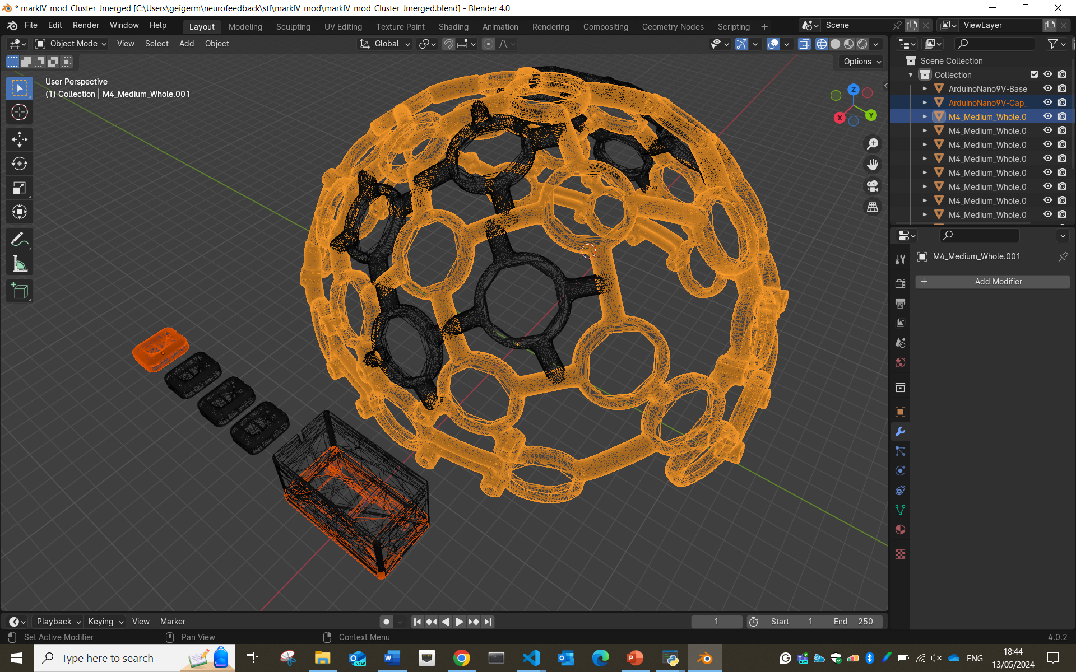
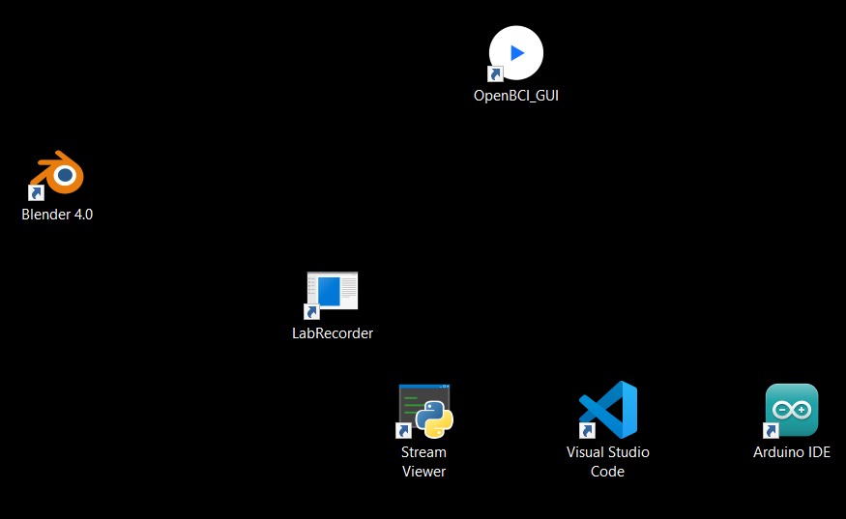
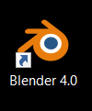

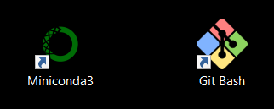
LSL

Slide 20
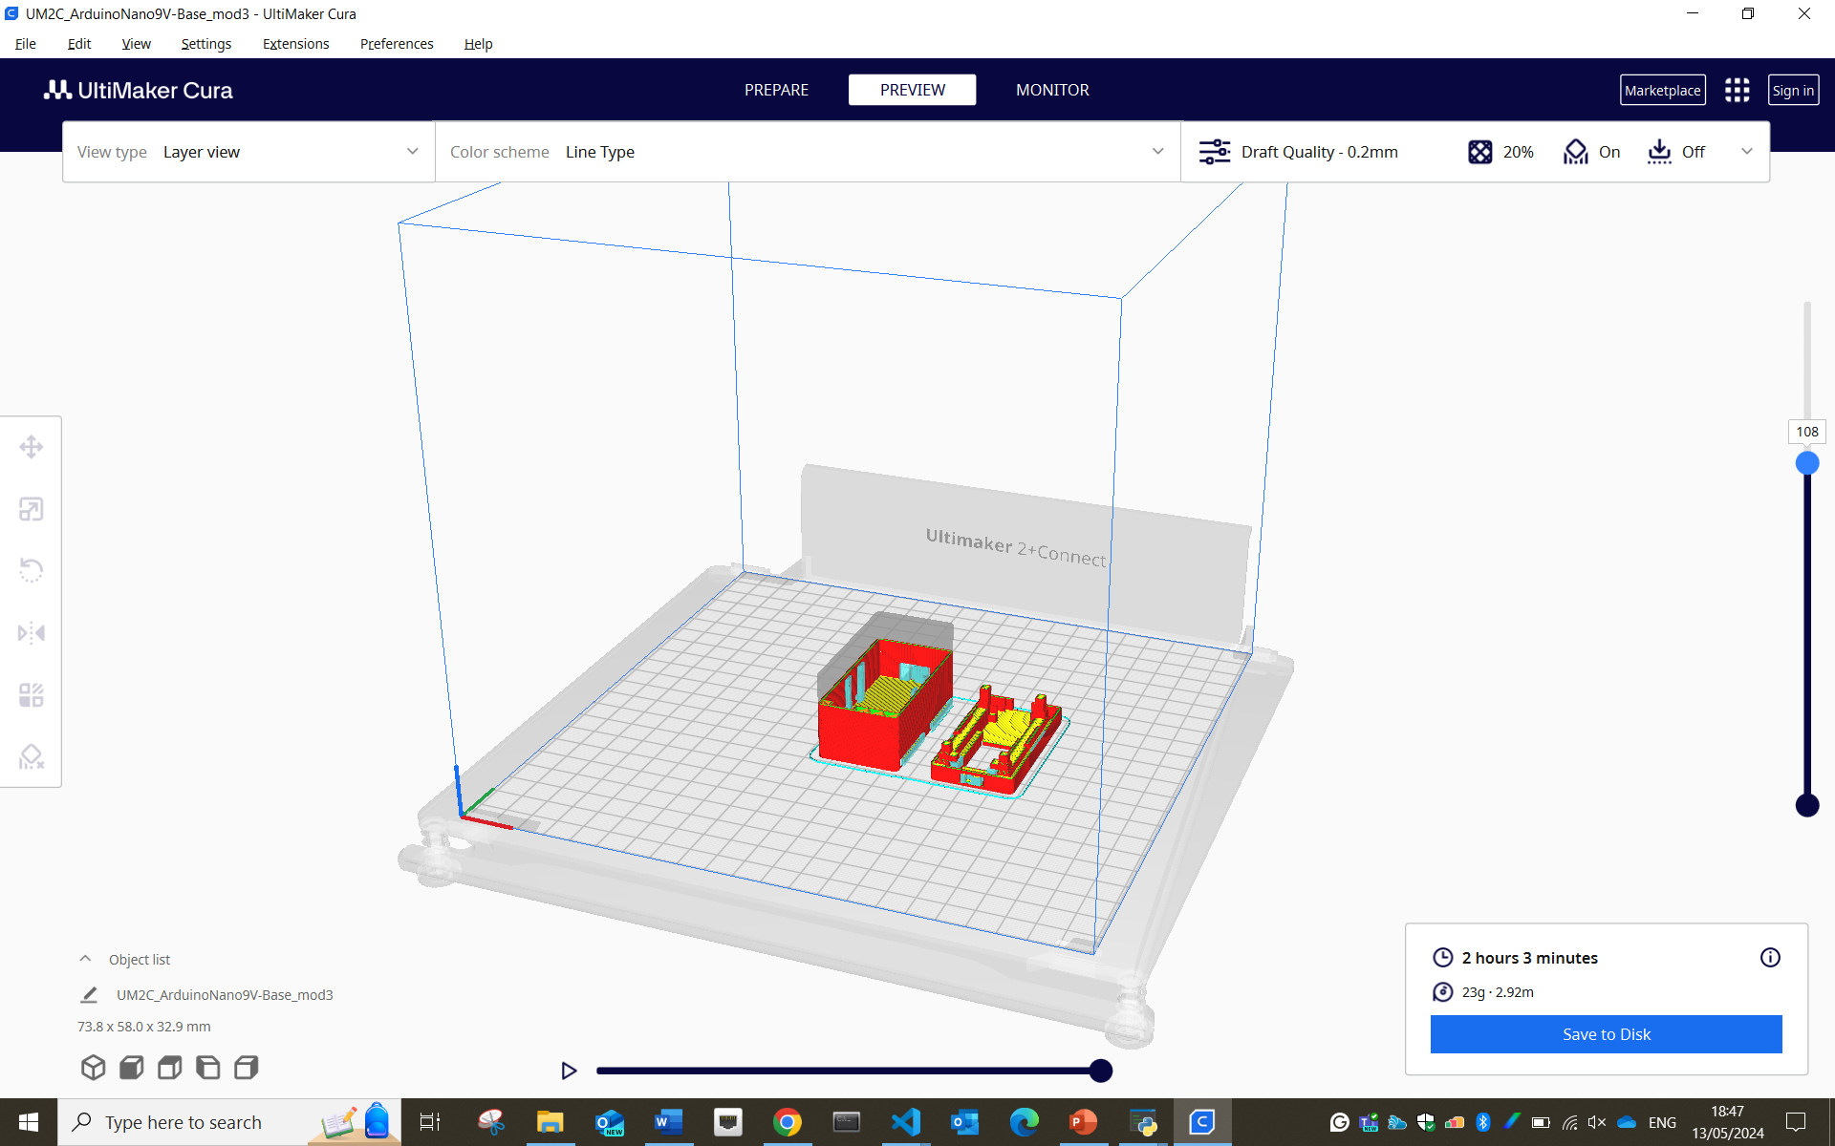
LSL

Slide 21
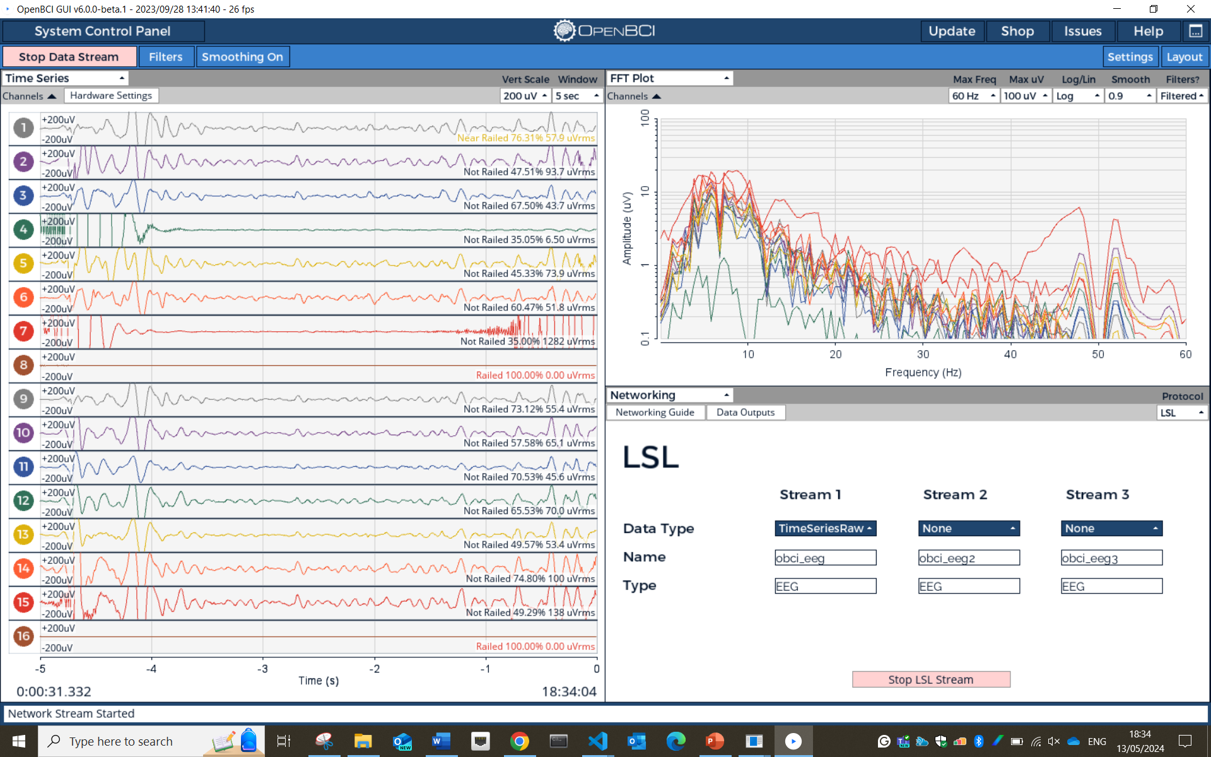
LSL

Slide 22
Lab Streaming Layer
stream, receive, synchronise, and record neural, physiological, and behavioural data streams acquired from diverse sensor hardware with millisecond-precision
LSL

Slide 23
EEG
EMG
IMUs
Lab Streaming Layer
stream, receive, synchronise, and record neural, physiological, and behavioural data streams acquired from diverse sensor hardware with millisecond-precision
LSL
…

Slide 24
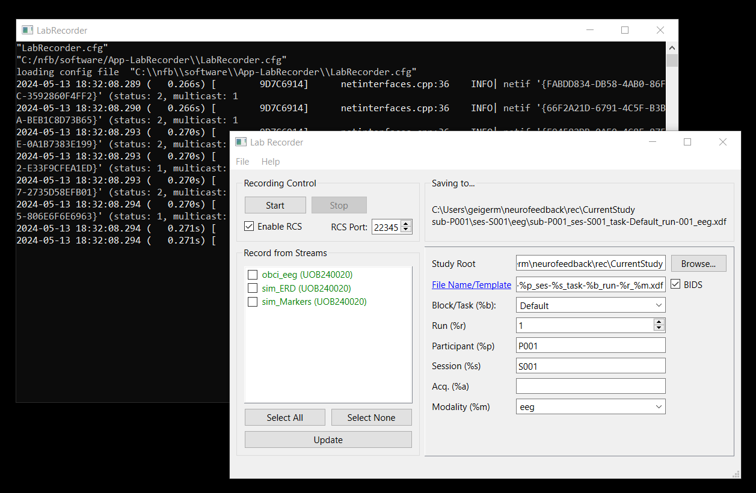
Lab Streaming Layer
stream, receive, synchronise, and record neural, physiological, and behavioural data streams acquired from diverse sensor hardware with millisecond-precision
EEG
EMG
LSL
IMUs
…

Slide 25
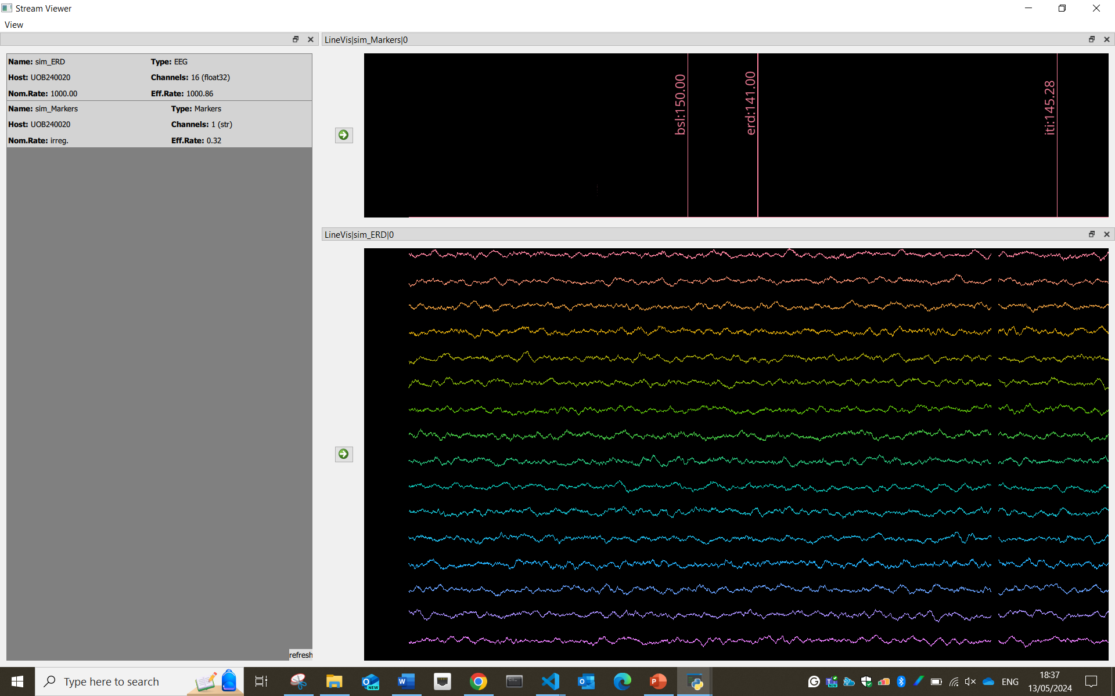
Lab Streaming Layer
stream, receive, synchronise, and record neural, physiological, and behavioural data streams acquired from diverse sensor hardware with millisecond-precision
LSL
EEG
EMG
IMUs
…

Slide 26
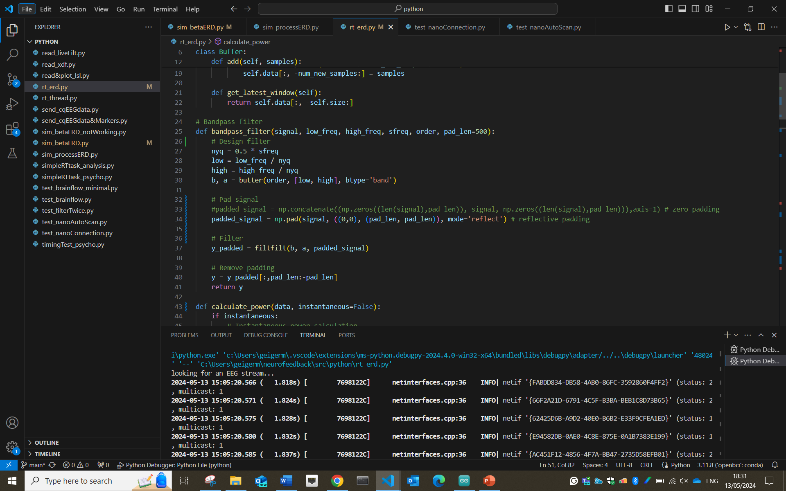
LSL

Slide 27
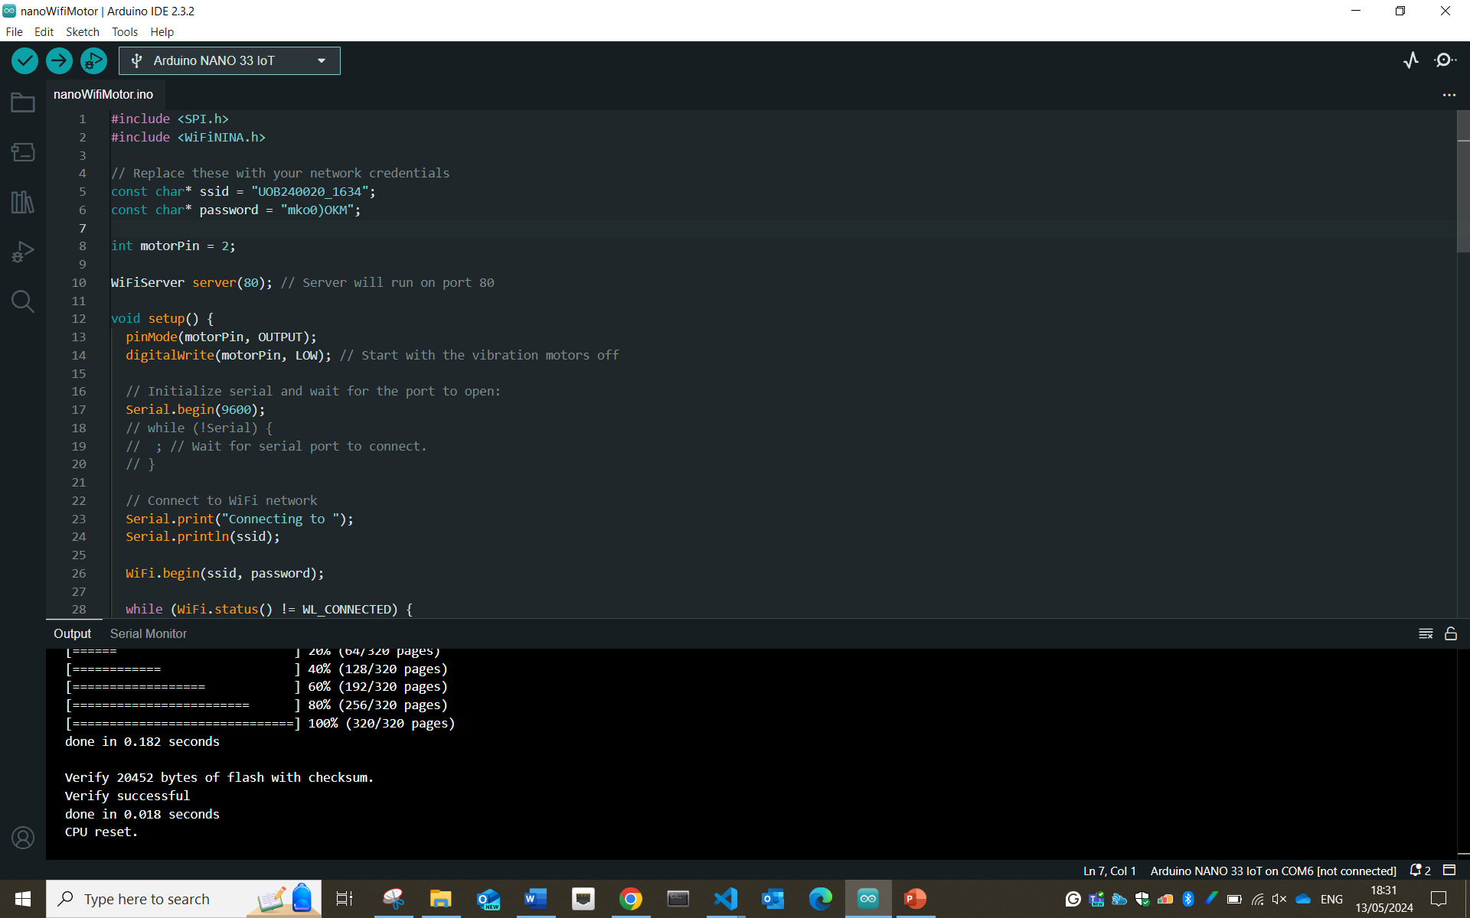
LSL

Slide 28
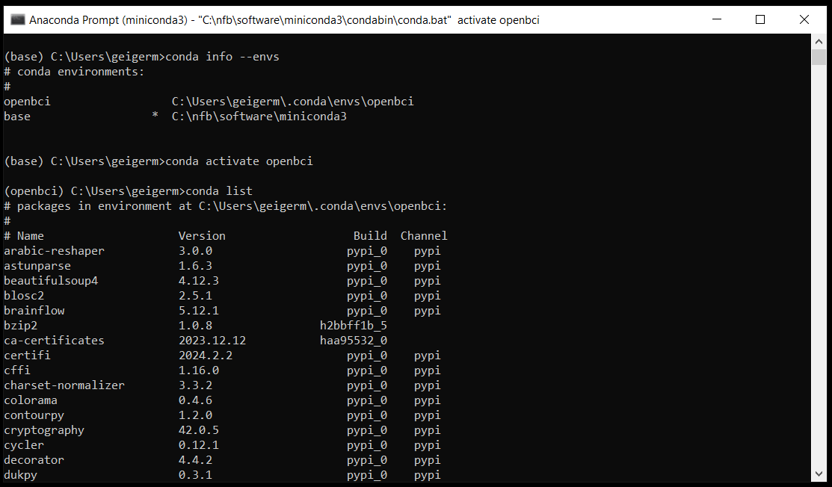
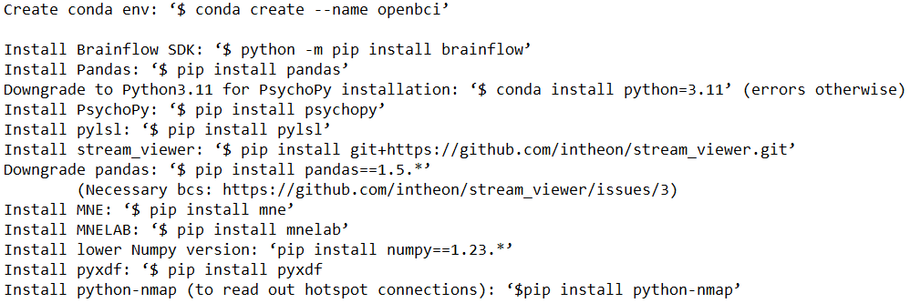
LSL

Slide 29
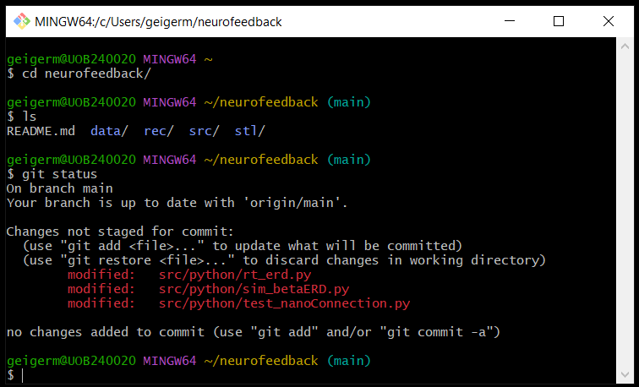
LSL

Slide 30
LSL

Slide 31
LSL

Slide 33
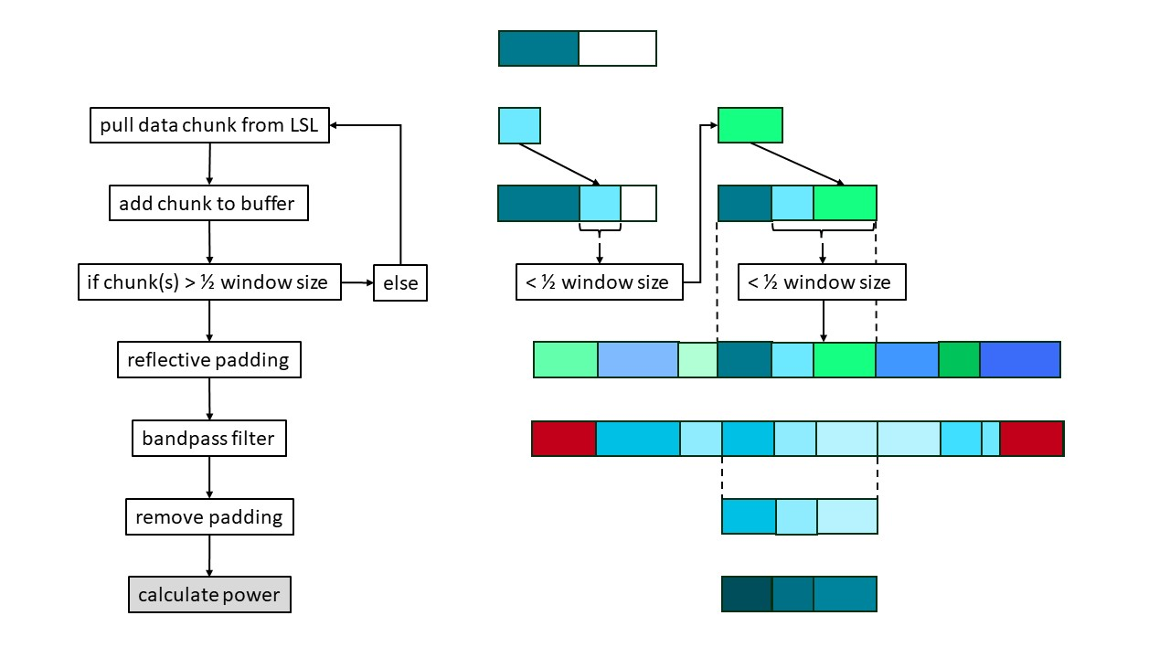
rtNFB
software
cqEEG
haptic feedback
LMM | RT ~ 1 + power + (1|subject)
power [s] | 0 – 1.5 | 0 – 0.3 | 0.4 - 0.7 | 0.8 – 1.1 | 1.2 -1.5
mu | 0.354 | 0.203 | 0.370 | 0.013 | 0.761
lowB | 0.066 | 0.588 | 0.007 | 0.021 | 0.992
highB | 0.742 | 0.538 | 0.854 | 0.083 | 0.861
beta | 0.246 | 0.501 | 0.150 | 0.022 | 0.984

Slide 34
software
rtNFB
cqEEG
haptic feedback
LMM | RT ~ 1 + power + (1|subject)
power [s] | 0 – 1.5 | 0 – 0.3 | 0.4 - 0.7 | 0.8 – 1.1 | 1.2 -1.5
mu | 0.354 | 0.203 | 0.370 | 0.013 | 0.761
lowB | 0.066 | 0.588 | 0.007 | 0.021 | 0.992
highB | 0.742 | 0.538 | 0.854 | 0.083 | 0.861
beta | 0.246 | 0.501 | 0.150 | 0.022 | 0.984

Slide 35
software
rtNFB
cqEEG
haptic feedback
LMM | RT ~ 1 + power + (1|subject)
power [s] | 0 – 1.5 | 0 – 0.3 | 0.4 - 0.7 | 0.8 – 1.1 | 1.2 -1.5
mu | 0.354 | 0.203 | 0.370 | 0.013 | 0.761
lowB | 0.066 | 0.588 | 0.007 | 0.021 | 0.992
highB | 0.742 | 0.538 | 0.854 | 0.083 | 0.861
beta | 0.246 | 0.501 | 0.150 | 0.022 | 0.984

Slide 36
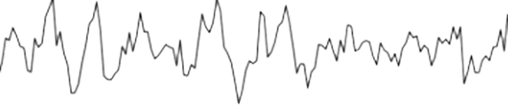
software
250 ms
rtNFB
haptic feedback
cqEEG
LMM | RT ~ 1 + power + (1|subject)
power [s] | 0 – 1.5 | 0 – 0.3 | 0.4 - 0.7 | 0.8 – 1.1 | 1.2 -1.5
mu | 0.354 | 0.203 | 0.370 | 0.013 | 0.761
lowB | 0.066 | 0.588 | 0.007 | 0.021 | 0.992
highB | 0.742 | 0.538 | 0.854 | 0.083 | 0.861
beta | 0.246 | 0.501 | 0.150 | 0.022 | 0.984

Slide 37
250 ms
rtNFB

Slide 38
250 ms

Slide 39
250 ms

Slide 40
250 ms

Slide 41
250 ms

Slide 42
250 ms

Slide 43
pull data chunk from LSL

Slide 44
pull data chunk from LSL
add chunk to buffer

Slide 45
pull data chunk from LSL
add chunk to buffer
if chunk(s) ≥ ½ window size
else
< ½ window size

Slide 46
pull data chunk from LSL
add chunk to buffer
if chunk(s) ≥ ½ window size
else
< ½ window size

Slide 47
pull data chunk from LSL
add chunk to buffer
if chunk(s) ≥ ½ window size
else
< ½ window size

Slide 48
pull data chunk from LSL
add chunk to buffer
if chunk(s) ≥ ½ window size
else
< ½ window size

Slide 49
pull data chunk from LSL
add chunk to buffer
if chunk(s) ≥ ½ window size
else
< ½ window size
> ½ window size

Slide 50
pull data chunk from LSL
add chunk to buffer
if chunk(s) ≥ ½ window size
else
< ½ window size
> ½ window size
reflective padding
bandpass filter

Slide 51
pull data chunk from LSL
add chunk to buffer
if chunk(s) ≥ ½ window size
else
< ½ window size
> ½ window size
reflective padding
bandpass filter

Slide 52
pull data chunk from LSL
add chunk to buffer
if chunk(s) ≥ ½ window size
else
< ½ window size
> ½ window size
reflective padding
bandpass filter
remove padding

Slide 53
250 ms
1
2
3
4
5
pull data chunk from LSL
add chunk to buffer
if chunk(s) ≥ ½ window size
else
< ½ window size
> ½ window size
reflective padding
bandpass filter
remove padding
calculate median power

Slide 54
250 ms
1
2
3
4
5
pull data chunk from LSL
add chunk to buffer
if chunk(s) ≥ ½ window size
else
< ½ window size
> ½ window size
reflective padding
bandpass filter
remove padding
calculate median power
thresholding
threshold

Slide 55
pull data chunk from LSL
250 ms
add chunk to buffer
1
if chunk(s) ≥ ½ window size
else
2
3
4
5
reflective padding
bandpass filter
remove padding
calculate median power
thresholding
threshold
< ½ window size
> ½ window size

Slide 56
30 s
pull data chunk from LSL
250 ms
add chunk to buffer
1
if chunk(s) ≥ ½ window size
else
2
3
4
…
5
reflective padding
bandpass filter
239
remove padding
calculate median power
thresholding
threshold

Slide 57
30 s
pull data chunk from LSL
250 ms
add chunk to buffer
1
if chunk(s) ≥ ½ window size
else
2
3
4
…
reflective padding
5
bandpass filter
239
remove padding
calculate median power
median power
thresholding
threshold

Slide 58
30 s
250 ms
250 ms
pull data chunk from LSL
add chunk to buffer
if chunk(s) ≥ ½ window size
else
…
reflective padding
1
2
3
4
5
239
bandpass filter
remove padding
calculate median power
median power
thresholding
threshold

Slide 59
pull data chunk from LSL
add chunk to buffer
if chunk(s) ≥ ½ window size
else
…
reflective padding
1
2
3
4
5
239
bandpass filter
remove padding
n
calculate median power
median power
thresholding
threshold
beta power
Xth percentile

Slide 60
pull data chunk from LSL
add chunk to buffer
if chunk(s) ≥ ½ window size
else
…
reflective padding
1
2
3
4
5
239
bandpass filter
Xth percentile
remove padding
n
calculate median power
median power
thresholding
threshold
beta power
feedback

Slide 61
pull data chunk from LSL
add chunk to buffer
if chunk(s) ≥ ½ window size
else
…
reflective padding
1
2
3
4
5
239
bandpass filter
Xth percentile
remove padding
feedback
n
calculate median power
median power
thresholding
threshold
beta power

Slide 62
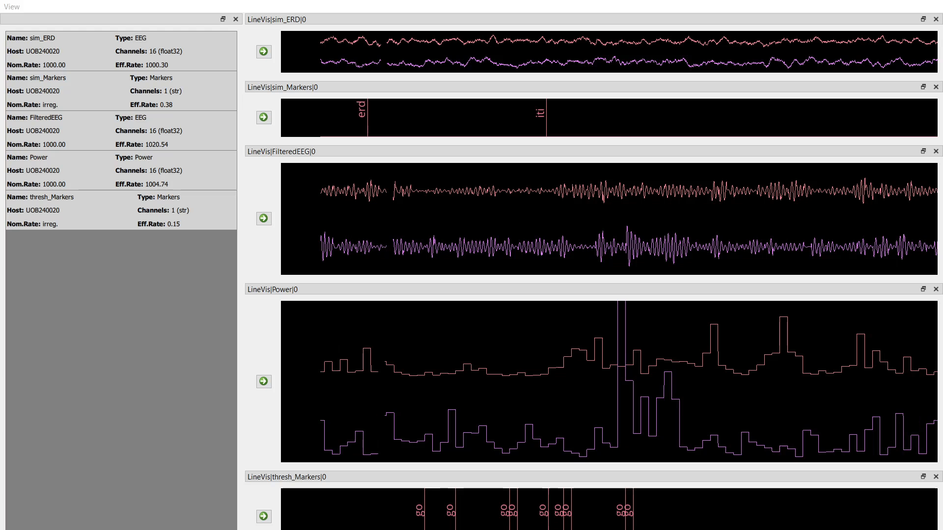

Slide 63
software
rtNFB
cqEEG
haptic feedback
LMM | RT ~ 1 + power + (1|subject)
power [s] | 0 – 1.5 | 0 – 0.3 | 0.4 - 0.7 | 0.8 – 1.1 | 1.2 -1.5
mu | 0.354 | 0.203 | 0.370 | 0.013 | 0.761
lowB | 0.066 | 0.588 | 0.007 | 0.021 | 0.992
highB | 0.742 | 0.538 | 0.854 | 0.083 | 0.861
beta | 0.246 | 0.501 | 0.150 | 0.022 | 0.984

Slide 64
software
rtNFB
cqEEG
haptic feedback
LMM | RT ~ 1 + power + (1|subject)
power [s] | 0 – 1.5 | 0 – 0.3 | 0.4 - 0.7 | 0.8 – 1.1 | 1.2 -1.5
mu | 0.354 | 0.203 | 0.370 | 0.013 | 0.761
lowB | 0.066 | 0.588 | 0.007 | 0.021 | 0.992
highB | 0.742 | 0.538 | 0.854 | 0.083 | 0.861
beta | 0.246 | 0.501 | 0.150 | 0.022 | 0.984

Slide 65
software
rtNFB
cqEEG
haptic feedback
LMM | RT ~ 1 + power + (1|subject)
power [s] | 0 – 1.5 | 0 – 0.3 | 0.4 - 0.7 | 0.8 – 1.1 | 1.2 -1.5
mu | 0.354 | 0.203 | 0.370 | 0.013 | 0.761
lowB | 0.066 | 0.588 | 0.007 | 0.021 | 0.992
highB | 0.742 | 0.538 | 0.854 | 0.083 | 0.861
beta | 0.246 | 0.501 | 0.150 | 0.022 | 0.984

Slide 66
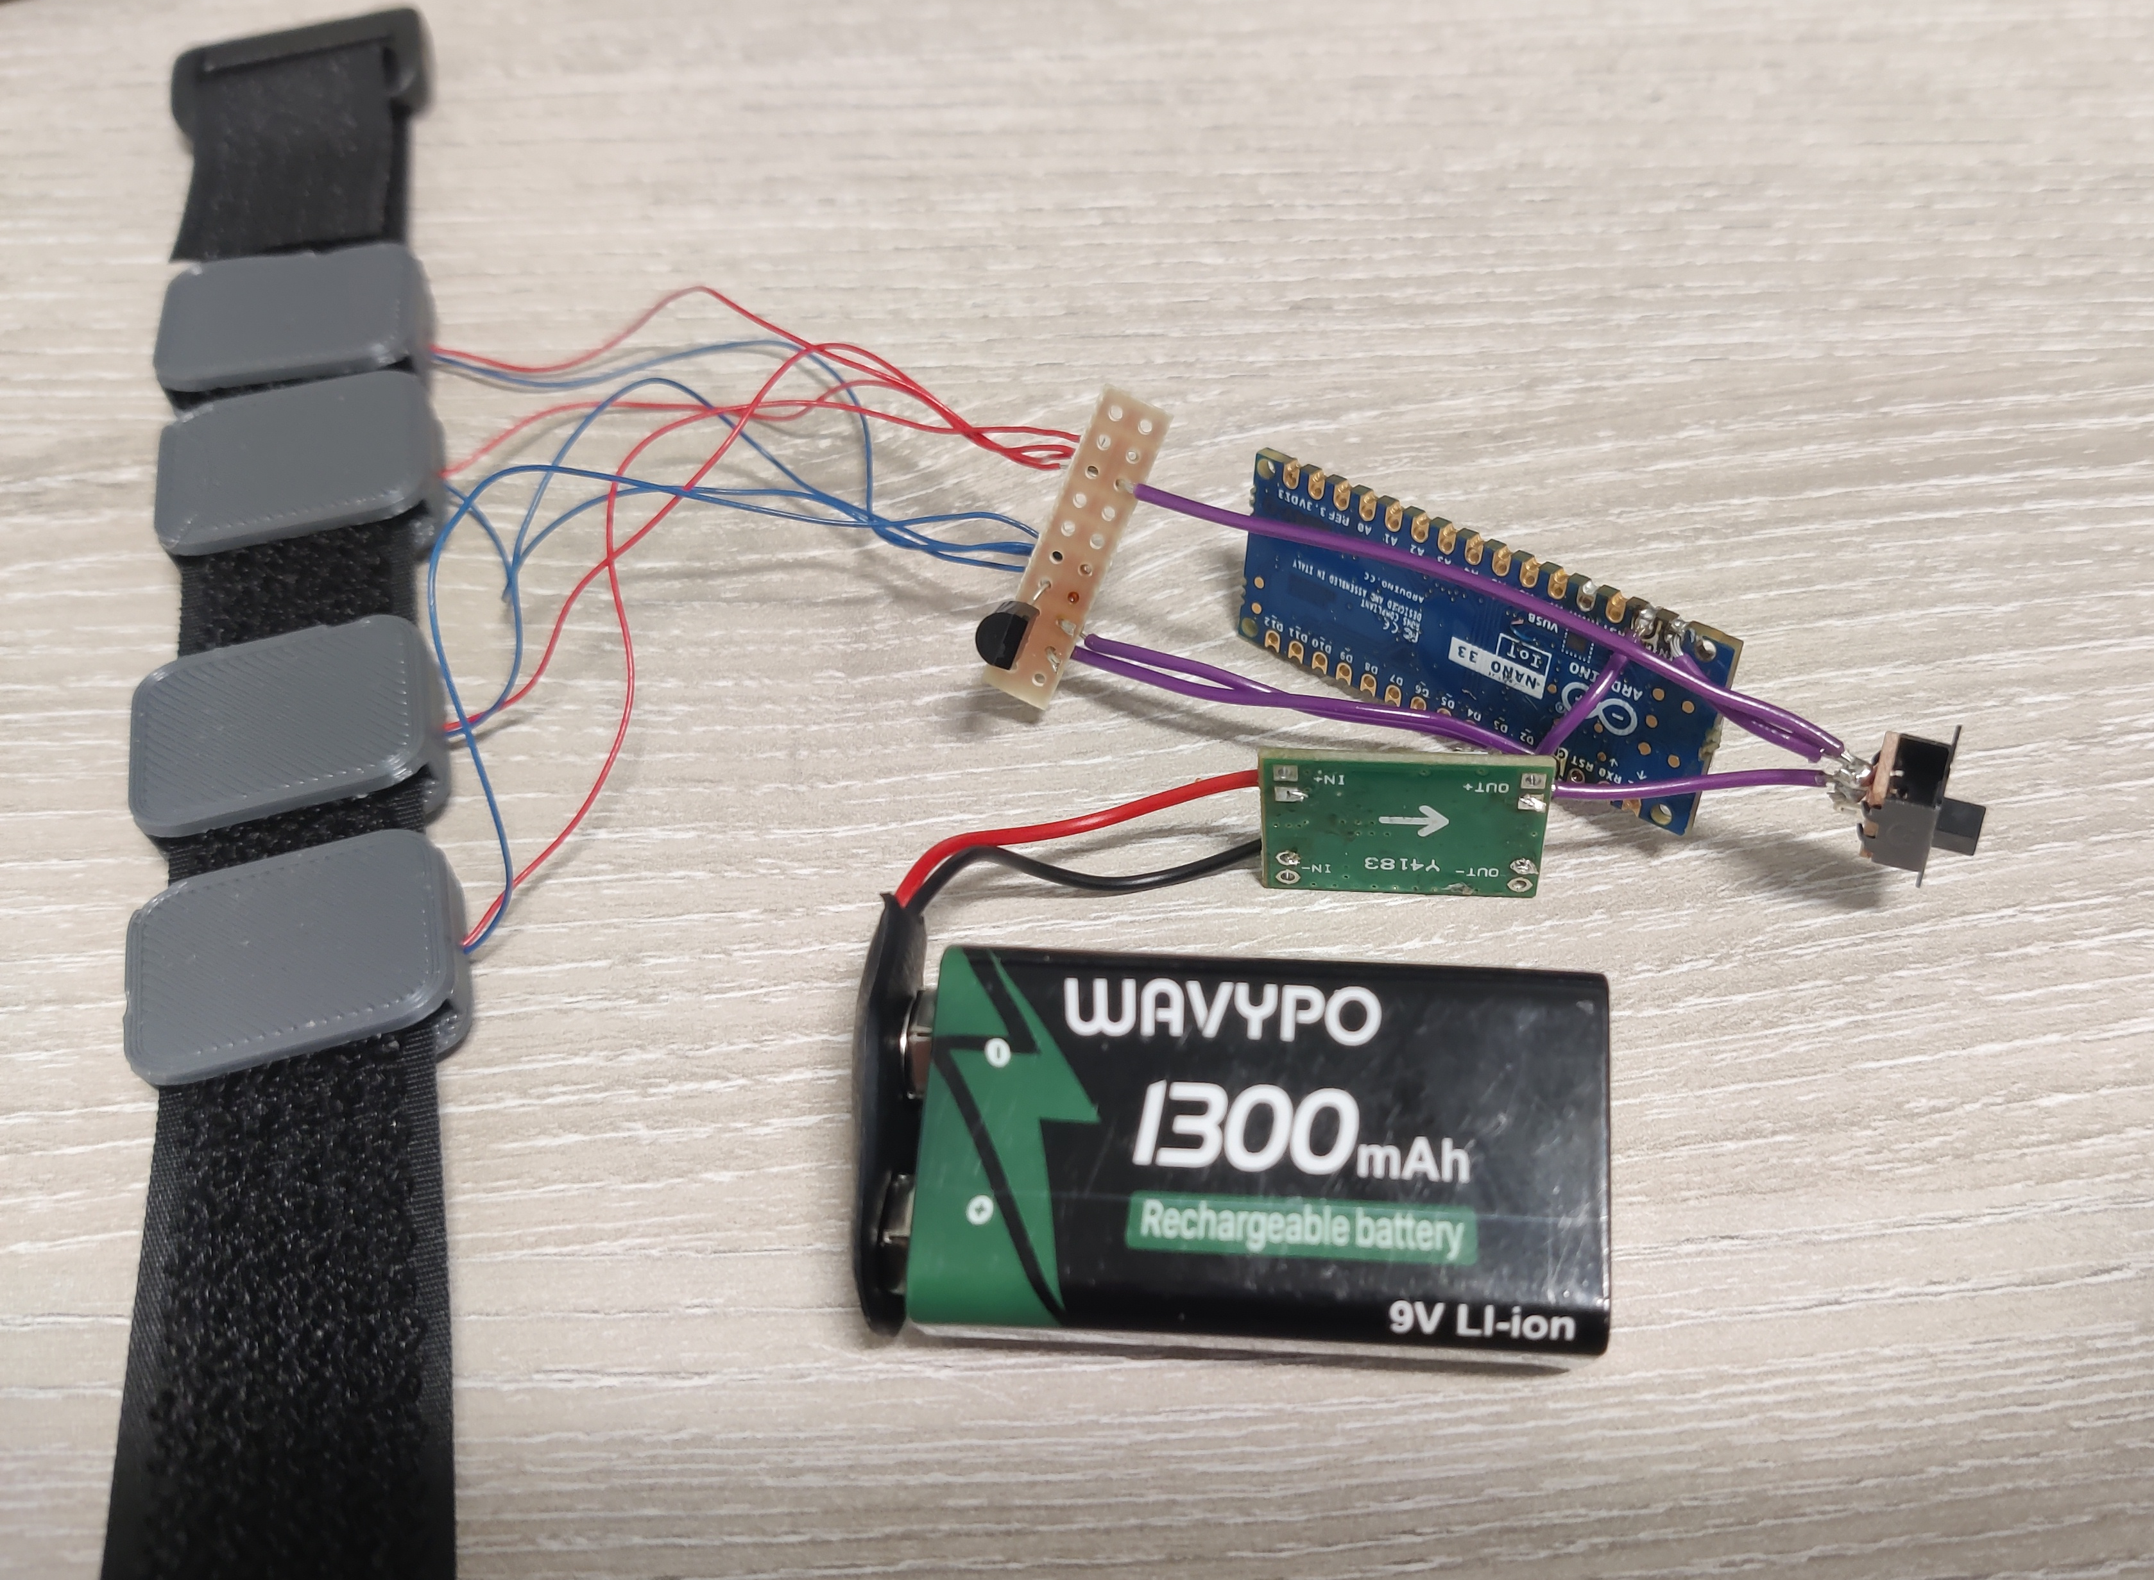
software
rtNFB
haptic feedback
cqEEG
LMM | RT ~ 1 + power + (1|subject)
power [s] | 0 – 1.5 | 0 – 0.3 | 0.4 - 0.7 | 0.8 – 1.1 | 1.2 -1.5
mu | 0.354 | 0.203 | 0.370 | 0.013 | 0.761
lowB | 0.066 | 0.588 | 0.007 | 0.021 | 0.992
highB | 0.742 | 0.538 | 0.854 | 0.083 | 0.861
beta | 0.246 | 0.501 | 0.150 | 0.022 | 0.984

Slide 67
haptic feedback

Slide 68
haptic feedback

Slide 69
haptic feedback

Slide 70
haptic feedback

Slide 71
haptic feedback

Slide 72
haptic feedback

Slide 73
software
rtNFB
haptic feedback
cqEEG
LMM | RT ~ 1 + power + (1|subject)
power [s] | 0 – 1.5 | 0 – 0.3 | 0.4 - 0.7 | 0.8 – 1.1 | 1.2 -1.5
mu | 0.354 | 0.203 | 0.370 | 0.013 | 0.761
lowB | 0.066 | 0.588 | 0.007 | 0.021 | 0.992
highB | 0.742 | 0.538 | 0.854 | 0.083 | 0.861
beta | 0.246 | 0.501 | 0.150 | 0.022 | 0.984

Slide 74
software
rtNFB
cqEEG
haptic feedback
LMM | RT ~ 1 + power + (1|subject)
power [s] | 0 – 1.5 | 0 – 0.3 | 0.4 - 0.7 | 0.8 – 1.1 | 1.2 -1.5
mu | 0.354 | 0.203 | 0.370 | 0.013 | 0.761
lowB | 0.066 | 0.588 | 0.007 | 0.021 | 0.992
highB | 0.742 | 0.538 | 0.854 | 0.083 | 0.861
beta | 0.246 | 0.501 | 0.150 | 0.022 | 0.984

Slide 75
software
rtNFB
cqEEG
haptic feedback
LMM | RT ~ 1 + power + (1|subject)
power [s] | 0 – 1.5 | 0 – 0.3 | 0.4 - 0.7 | 0.8 – 1.1 | 1.2 -1.5
mu | 0.354 | 0.203 | 0.370 | 0.013 | 0.761
lowB | 0.066 | 0.588 | 0.007 | 0.021 | 0.992
highB | 0.742 | 0.538 | 0.854 | 0.083 | 0.861
beta | 0.246 | 0.501 | 0.150 | 0.022 | 0.984

